Slide 1


Scripting at the Speed of Thought
Using Lua in C++ with sol3
September 28th, 2018 – CppCon, Meydenbauer Center
@thephantomderp #sol3an

Slide 2
Scripting
Treating code as data
Means of extending your application beyond ship time
Delegate smaller, simpler tasks to easy-to-use language

Slide 3
Why Script?
Extending your application
without re-compilation
without fragile DLLs/shared libraries
Lowering barrier to entry
Complexity of main language (C++, Java, Haskell) versus complexity of scripting language (Lua, Python, Javascript)
Little / no IDE or build setup required

Slide 4

“What about the Standard?”
There is no scripting or interop built into the standard library
… at all
Will compare to other libraries, however!

Slide 5

Lua, the Scripting Language
Simple dynamic language
Grammar fits on a single page
Only 1 data structure – table
Minimalistic library
Famously used in
World of Warcraft (WoW), Redis database, Operating System components, Servers, Waze GUI, …

Slide 6
Lua, with C code
Entire VM is tiny and compiled with ANSI C
Portable to many, many compilers
Exposes library interface, the Lua C API
Stack-based: push values, call manipulation operations, pop leftover values
Fairly fast compared to other VMs

Slide 7
Lua C API: how-to-stack
my_table[“a”]
get my_table global
get field
lua_to{x} value
my_func(2)
push my_func global function
push argument
call, get return(s) using lua_to{x}

Slide 8
Okay, let’s scale it up…
other_func( my_table[“a”][“b”], my_func( 2 ) )

Slide 9

(╯°□°）╯︵┻━┻
Miss me with that noise, fam.

Slide 10
Limitations of C itself
No overloading – “which one do I need, again?”
lua_gettable()
lua_getglobal(const char*)
lua_getfield(const char*)
lua_geti(int) // version 5.3+
lua_rawgeti(int)
lua_rawget()
lua_rawgetp(void*)

Slide 11
Wrap/Abstract the C Code

Slide 12
Stack Namespace
sol::stack namespace that gets rid of all the C code
stack::push(v) –takes any value and pushes it with appropriate API
stack::get<T> –takes any type and retrieves it with appropriate API
stack::check<T> –takes any type and reports if it exists
“Type Rich” Programming
Tells us how to push, how to get based on type / argument type
Improves safety, increases developer throughput

Slide 13
Stack Namespace – Composed Operations
stack::get_field(key, table_index)
Optimize to lua_getfield if key is a string (or string-like)
Optimize to lua_getglobal if we are working with global table
Otherwise fallback to default lua_gettable
stack::set_field(key, value, table_index)
Optimize to lua_setfield if key is a string (or string-like)
Exactly like above

Slide 14
An example
lua_State* L = ...;
sol::stack::get_field<true>(L, "some_key");
int the_value = sol::stack::get<int>(L, -1);
lua_pop(L, 1);
lua_createtable(L, 0, 2);
sol::stack_reference ref(L, -1);
sol::stack::set_field(L, 1, "val1");
sol::stack::set_field(L, 2, "val2", ref.stack_index());
ref.pop();

Slide 15
Not High Enough
Still working with the stack, stack indices
This is good for a C developer, but what about a newcomer?
C++, have reusable data structures – mimic language:
table
function
userdata

Slide 16
Improving the Abstraction
0
reference and the rule of zero

Slide 17
Abstraction Layer 0
Lua has a “C registry”
Place were C API user can store references to Lua constructs
References are counted: only freed when reference count hits 0
Want table, function, thread, etc.
All must be reference counted in C and C++ code!

Slide 18
Abstraction Layer 0: Rule of 0
sol::reference
reference counting abstraction
Slightly similar to boost::intrusive_ptr
More accurate to proposed std::retain_ptr or ARC references
wg21.link/p0468
Increments on copy
Reference-steals on move
Decrements on destruct

Slide 19
Abstraction Layer 1: Reuse
class object : sol::reference { … };
Just add .as<T>() and .is<T>()
class function : sol::reference { … };
Just add .call() and operator()( … )
class table : sol::reference { … };
Just add .set() and .get() and operator[](…)

Slide 20
Abstraction Layer 2: Proxy
Need int x = f(obj) and my_class& y = f(1, 2)
Do not want to make 2 different types
Simple struct that has a templated implicit conversion operator
struct proxy { template <typename T> operator T () { … } };
my_table[“foo”] = “bar”; std::string bar = my_table[“foo”];
Same as above, plus:
operator= to handle assignment from anything
operator[] to “chain” lookup with int x = my_table[“bark”][“bjork”];

Slide 21
Abstraction Layer 2: Problems
“Unicorn” Proxies are weak to certain idioms:
int a, b, c; std::tie( a, b, c ) = f();
Asks for std::tuple<int&, int&, int&>
Cannot control return type of implicit or explicit conversions!
No way to hand back std::tuple<int, int, int>
Notes:
WEAKNESS – IT’S SUPER EFFECTIVE CHART

Slide 22
Abstraction Layer 2: Fixes?
Relevant fix paper for C++ San Diego meeting
p1193, Explicit Return Types for Implicit Conversion
struct proxy { template <typename T> handle_weird_tie_stuff_t<T> operator T () { … } };

Slide 23
Usertypes
The Glory of Sol

Slide 24
Usertypes are A M A Z I N G
The primary binding glue between C++ and Lua
Exposes C++ classes, their idioms, their properties cleanly and efficiently
But why take my word for it? Let’s just have a quick peek…

Slide 25

D E M O I N P R O G R E S S

Slide 26

But There’s More!
Usertypes – and sol2 in general – can also work with types and systems it does not know about
Put sol in your large commercial codebase, today
Use it incrementally without problem thanks to sol::state_view
Transition as fast or as slow as you desire

Slide 27
D E M O I N P R O G R E S S

Slide 28
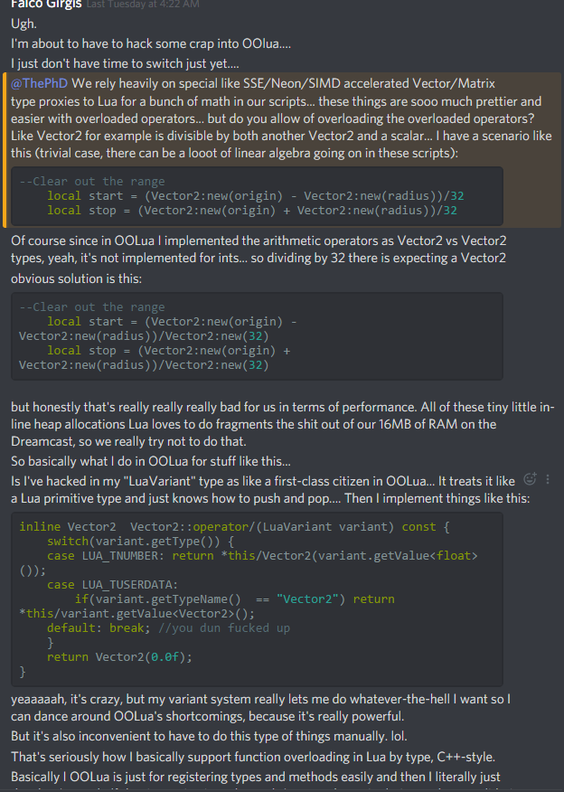
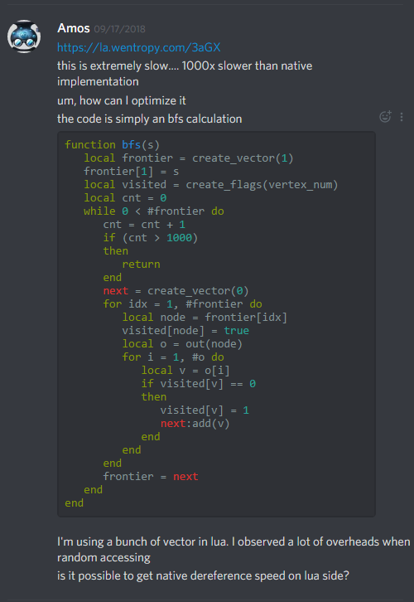
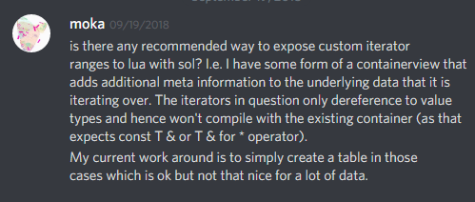
It is FEATURE PACKED!
Some people don’t even realize…

Slide 29

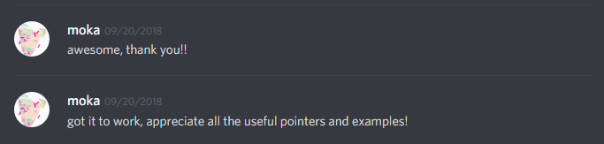
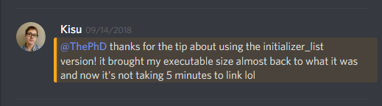
Witnessing Realizations in Real-time is fun

Slide 30
Customization Points
And the problem with Defaults

Slide 31
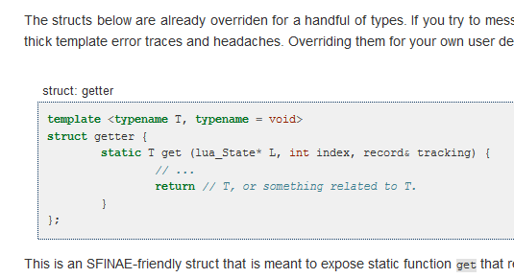
Past Customization: Struct Specializations
Specialize a template struct getter/checker/pusher
Works and scales
Users can add their own specializations

Slide 32
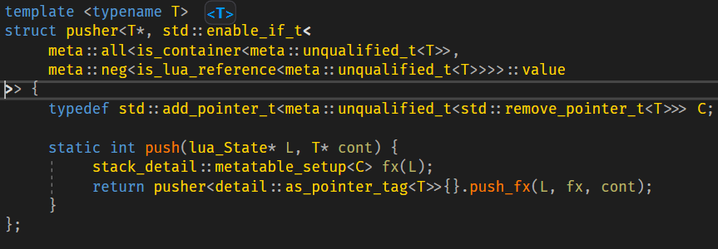
Past Customizations: Problem with Structs
Users do not like way e.g. int64_t or uint64_t or a container are handled
Impossible for them to extend if they are not careful of mutually exclusive SFINAE

Slide 33
Customization Layer Mk. II
Customization points are instead functions
attempt to call via ADL and priority tags (Thanks, Arthur O’Dwyer!)
sol_unqualified_get( priority_tag, types<custom_string>, … );
Hand user a priority tag type with higher ranking:
using priority_tag = max_priority;
Keep struct specializations for “fallback” and “defaults”
Clean separation

Slide 34

Customization Layer Mk. II: Compile Harder
N.B.: they are just regular functions
Implement in cpp files, export them
Compile heckin’ fast
Everyone knows how to write a function (!!)
Users do not have to understand SFINAE or template struct specialization
Vastly smaller amount of people SFINAE and struct specialize
Decreases barrier to entry

Slide 35
Speaking of Compile Times…

Slide 36
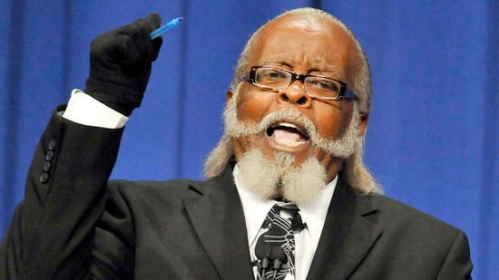
Compile Times + Compiler Memory Usage
Too. Damn. High.

Slide 37

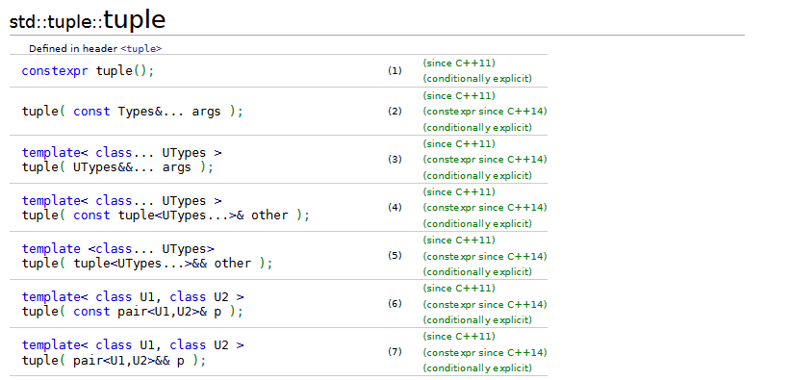
Tuple and SFINAE: the Greater Evils

Slide 38

A Spark of Moonlit Inspiration…
“Can I keep the same speed and still remove tuple and a lot of compile time information”?
Benchmark cpp file for sol3 took about 15% less time than sol2 benchmark file
But did we keep the same performance?!

Slide 39
So I implemented it. Today.
In the dark of the night. Just before my presentation.
The “I Like Anxiety” Challenge:
Ran benchmarks overnight and promised myself that I would modify presentation with the numbers in the morning

Slide 40
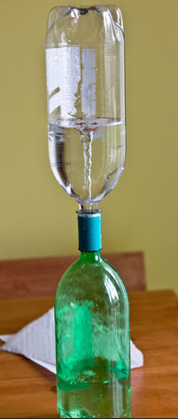
Idea: Virtual Base class, templated data?
Essentially:
std::vector<std::unique_ptr<binding_base>>
Do 4 things:
Store data in vector to give it a never-changing memory address
Get data as void* to transport through Lua + templated free function
Make sure either side of Lua abstraction preserves type information
Pass along the exact address

Slide 41

Sun Came Up, Benchmarks Finished…

Slide 42
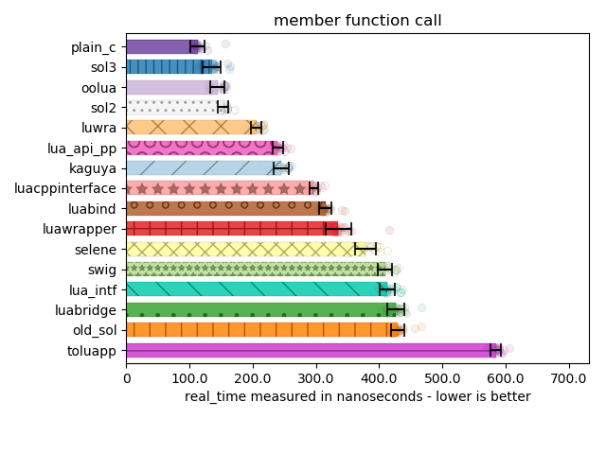

Nice.

Slide 43
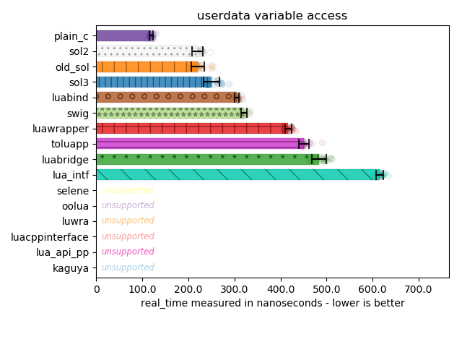
Nice.

Slide 44
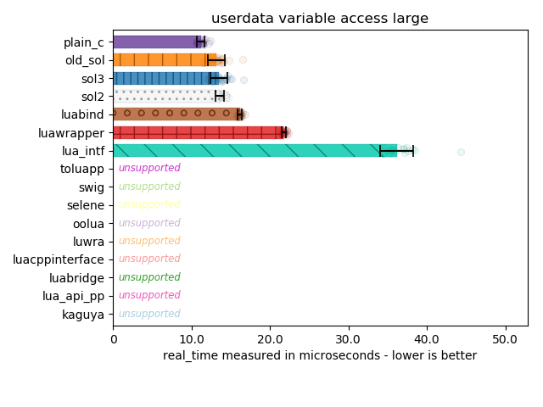
Nice.

Slide 45
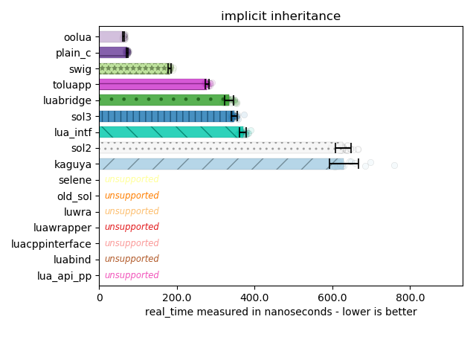
Nice.

Slide 46
Nailed It
Great performance metrics
So much room to decrease compile times
So many more features enabled by this exploration and the advancements!
sol3 pushed to its own branch
Until tests are converted and all pass
Hope to have something by the end of October, before the C++ San Diego meeting starts

Slide 47
My felt gratitude…
#include – for the graphs and being a wonderful community
Inspired a Python Talk
Companies and individuals who have used sol2 to success and have recommended it to others!
Corentin, Elias Daler, Orfeasz, Xottab_DUTY, and donators up to this point!
Jason Turner for telling me to start talking about sol2 and sol3!
Mother Eugenie, Sister Lorigiana

Slide 48



Thank YOU for coming!
@__phantomderp #sol3an
https://www.patreon.com/thephd
https://www.linkedin.com/in/thephd
https://github.com/ThePhD/
https://github.com/ThePhD/sol2
It’s hard to choose against Sean Parent and Hyrum Wright and Matt Godbolt and Odin Holmes! So thank you for making my first CppCon talk a great one!

